Slide 1
Reinforcement Learning HVAC System
Johnathan Kunz

Slide 2
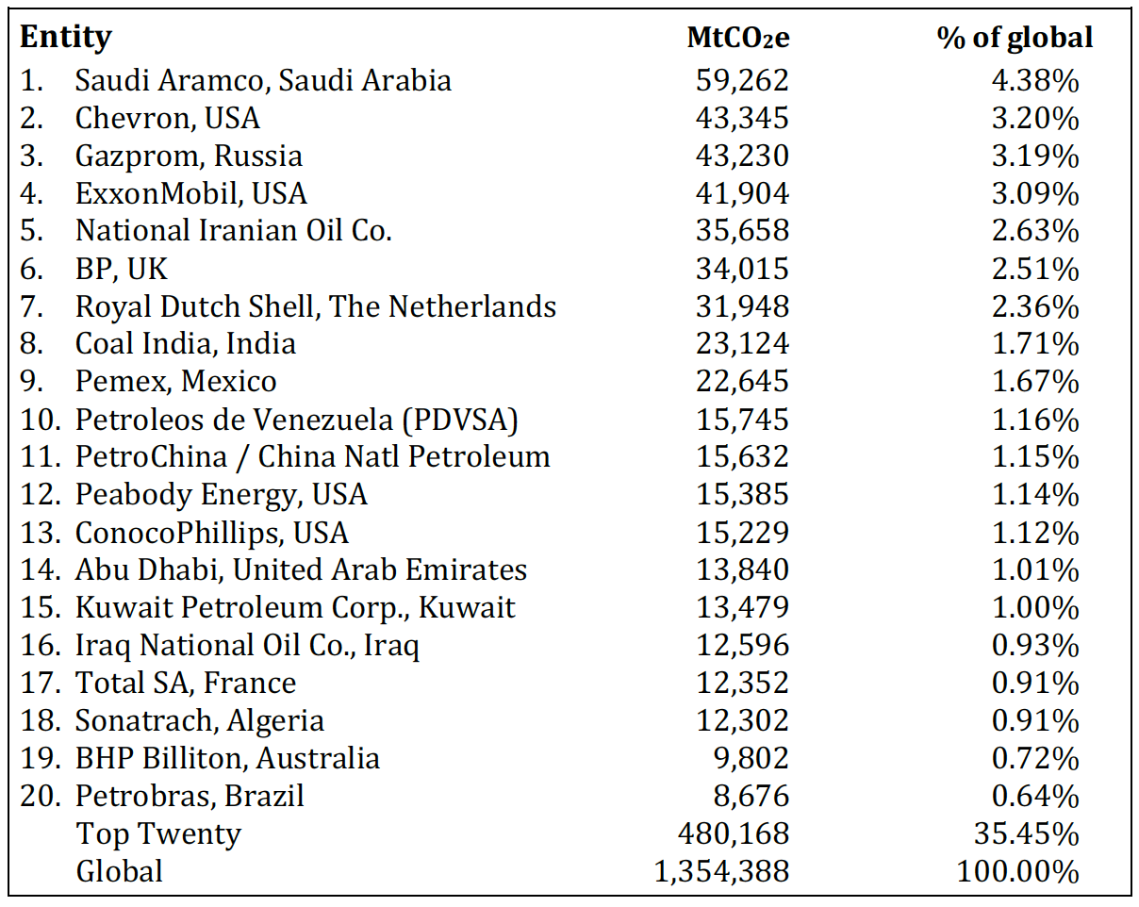
Methods and Objectives
The world is in a climate crisis. Although 71% of the worlds green house gas emissions come from 100 companies who for years have pushed down climate solutions, these emissions are also somewhat due to the consumption of their products. Individuals should also do their part to reduce their own carbon footprint, but the most work will be holding companies and governments accountable.

Slide 3
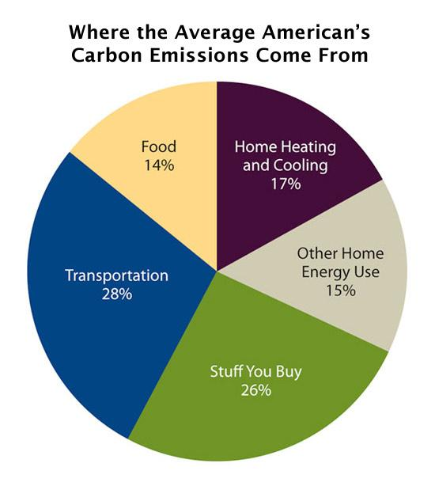
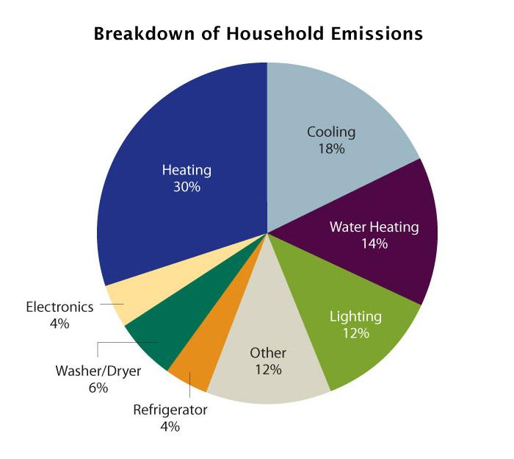
Methods and Objectives
As you can see from this graphic HVAC emissions make up a significant percentage of the average Americans Carbon Footprint. This is also an area less discussed when working on lowering your carbon footprint. Therefore this topic was chosen as a basis for the project.

Slide 4
The Problem
The system takes a weather file and a config file, as well as a pre-built house model in the environment. Through reinforcement learning on the system a model is created that efficiently manages temperature of a home.
Given inputs of a temperature weather file holding outside and ground temperatures, and also given a model of a home.
Desired outputs of a reinforcement learning model that has learned how to effectively manage the temperature of a home.

Slide 5
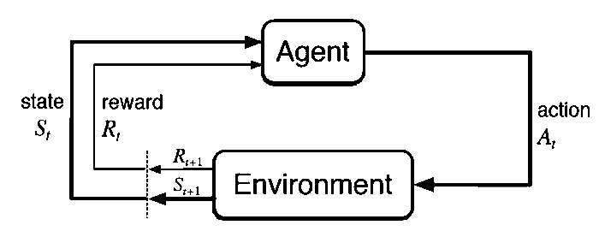
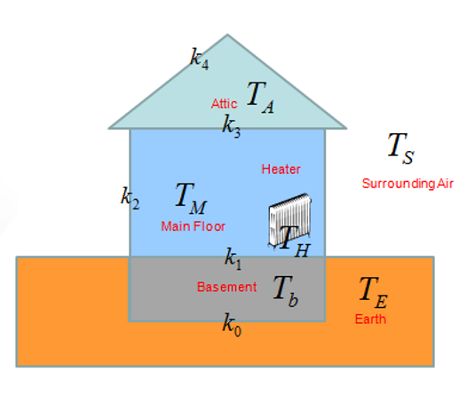
The Solution
Inputs:
Weather file containing temperatures and dates for those temperatures in order.
Config file containing initialization information for the environment such as lowest allowed temperatures for the environment.
A house model with barriers between rooms, hvac heaters and room fans for circulating the air.
The Method:
A reinforcement learner
Exit Conditions:
End of weather file reached
Uncomfortable temperature extreme reached.

Slide 6
Observations and Actions
Num | Observation | Min | Max
0 | Air Temp | -273 | Inf
1 | Ground Temp | -273 | Inf
2 | HVAC Temp | -273 | Inf
3 | Basement Temp | 0 | 40
4 | Main Temp | 0 | 40
5 | Attic Temp | 0 | 40
6 | Air Temp Future (2 hrs) | -273 | Inf
Num | Action
0 | Run the cooler.
1 | Run nothing.
2 | Run the heater on.
3 | Run fan of basement to main room.
4 | Run fan of main room and attic.
5 | Run all fans.

Slide 7
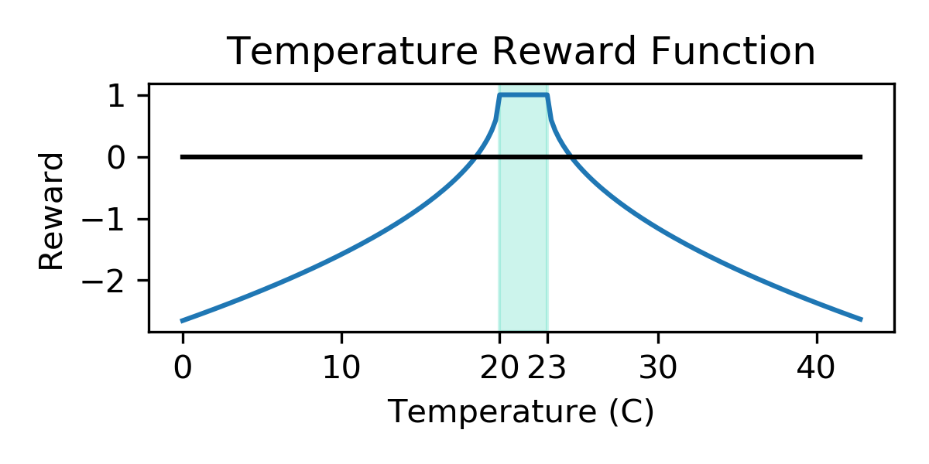
Reward
Reward
75% Temperature reward
25% Action Cost
Num | Action | Cost
0 | Run the cooler. | -1.0
1 | Run nothing. | 0.0
2 | Run the heater. | -1.0
3 | Run fan of basement to main room. | -0.25
4 | Run fan of main room and attic. | -0.25
5 | Run all fans. | -0.5

Slide 8
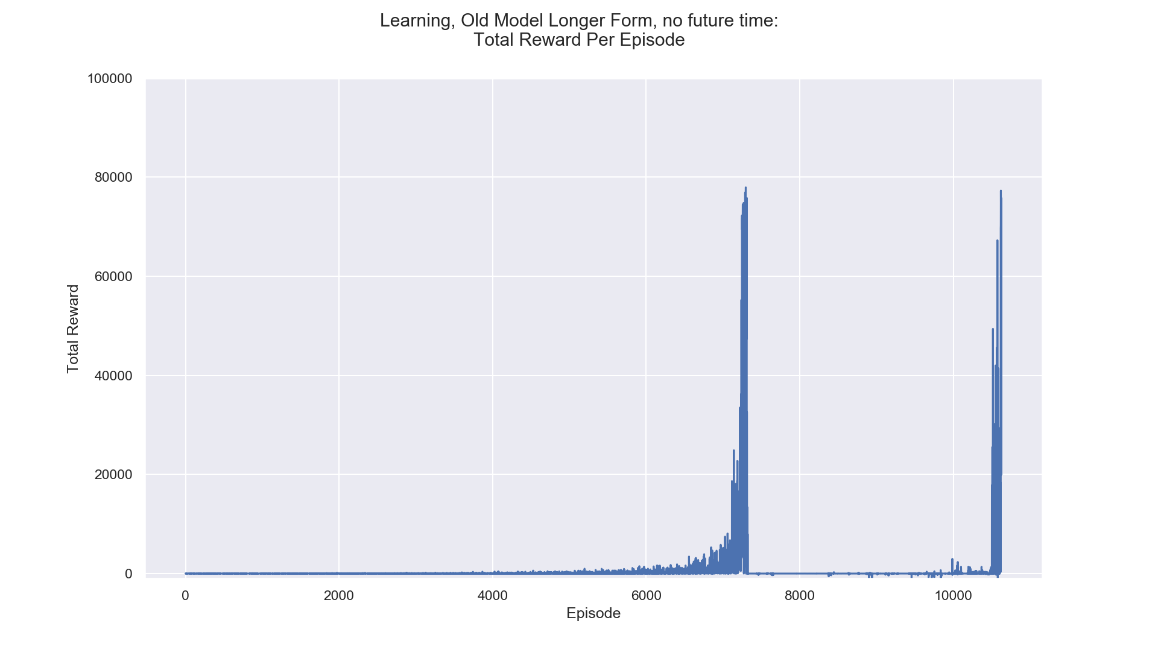
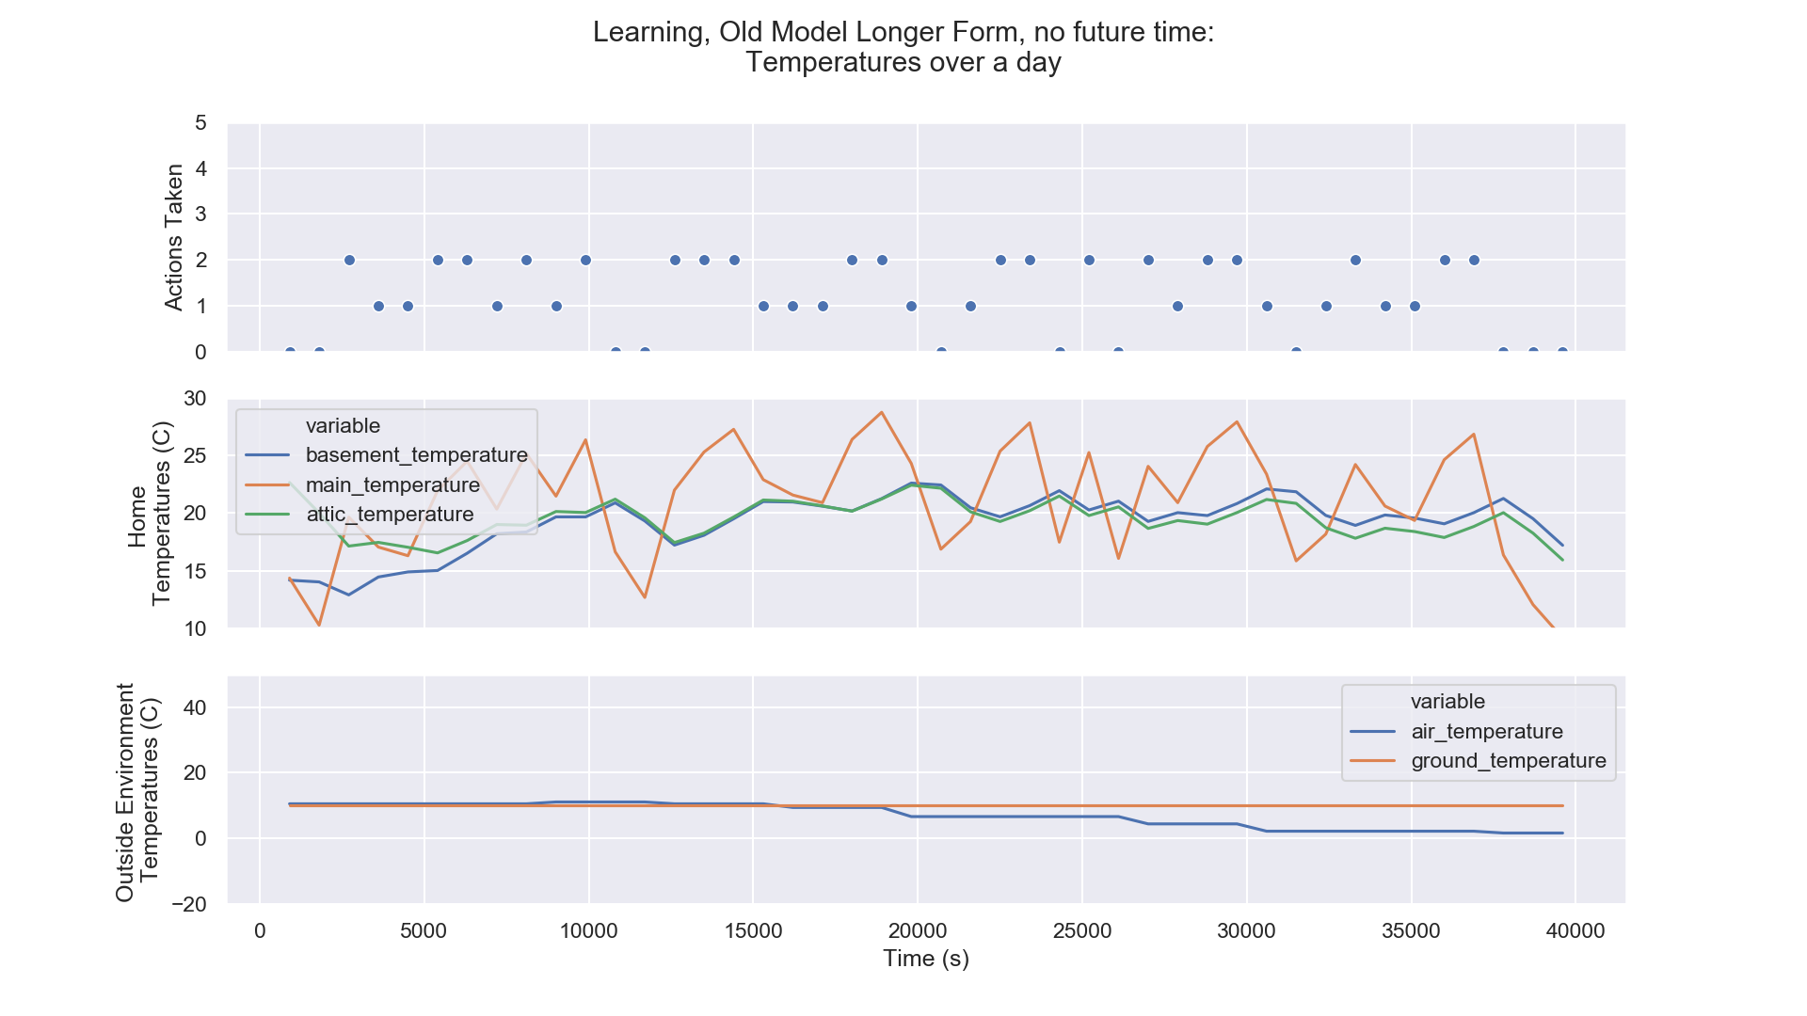
Results, Original Model
This data is from the run of the original model as I inherited it from the previous student. It has only a heater and cooler running in the homes main room, with the standard observations, sans the future temperature. In this the spikes occur when the learner becomes smart enough to read the whole weather file.

Slide 9
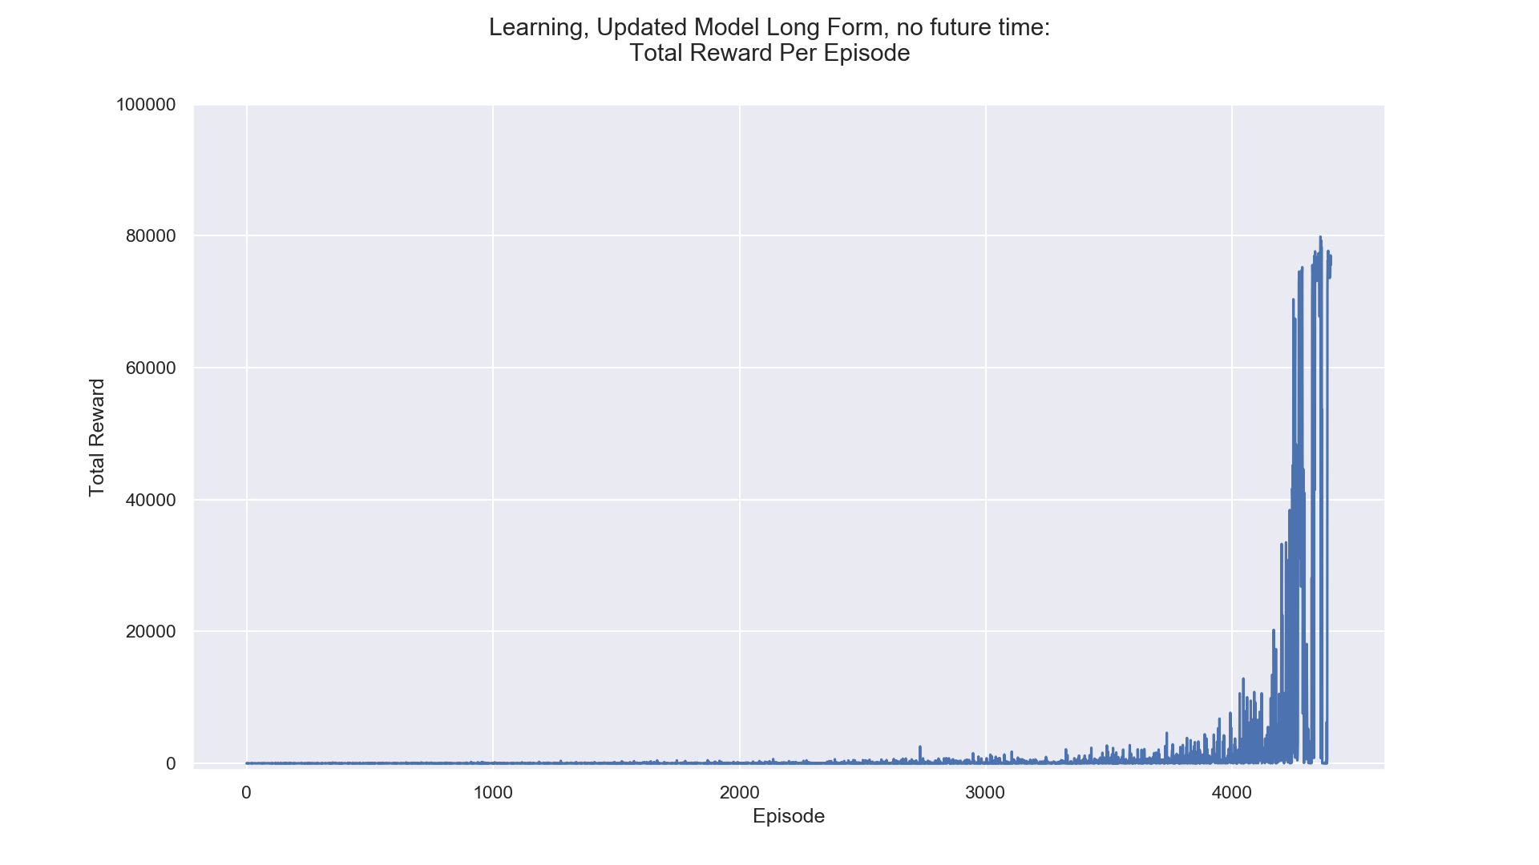
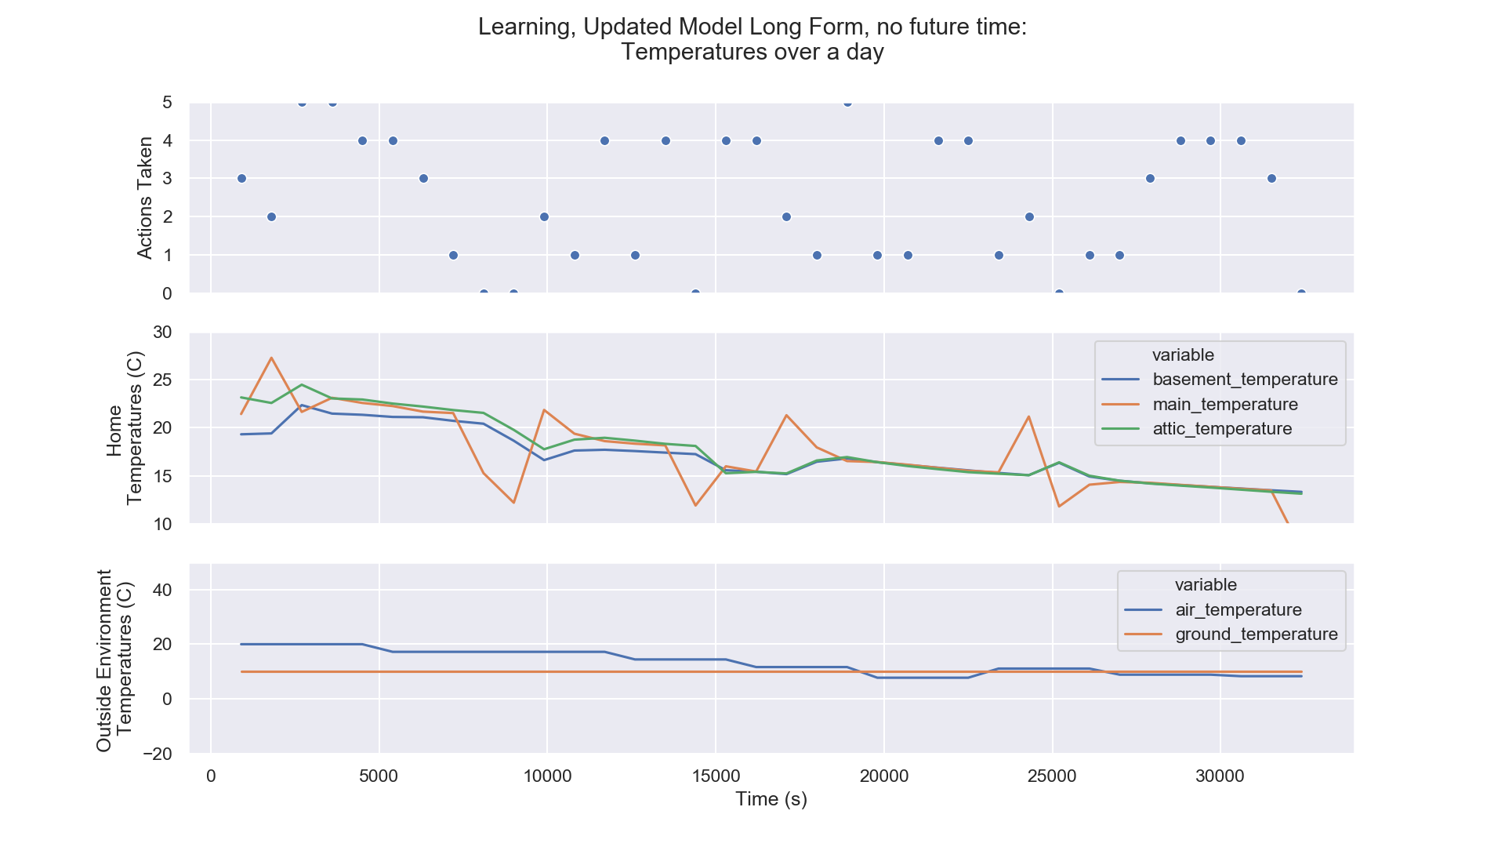
Results, New Model, Without Future Temperature
This data is from the run of the updated model I made. This model can run the heater or cooler in the main room or mix the air of the different rooms using fans. This model also hasn’t implemented the temperature the simulation will be in the future.

Slide 10
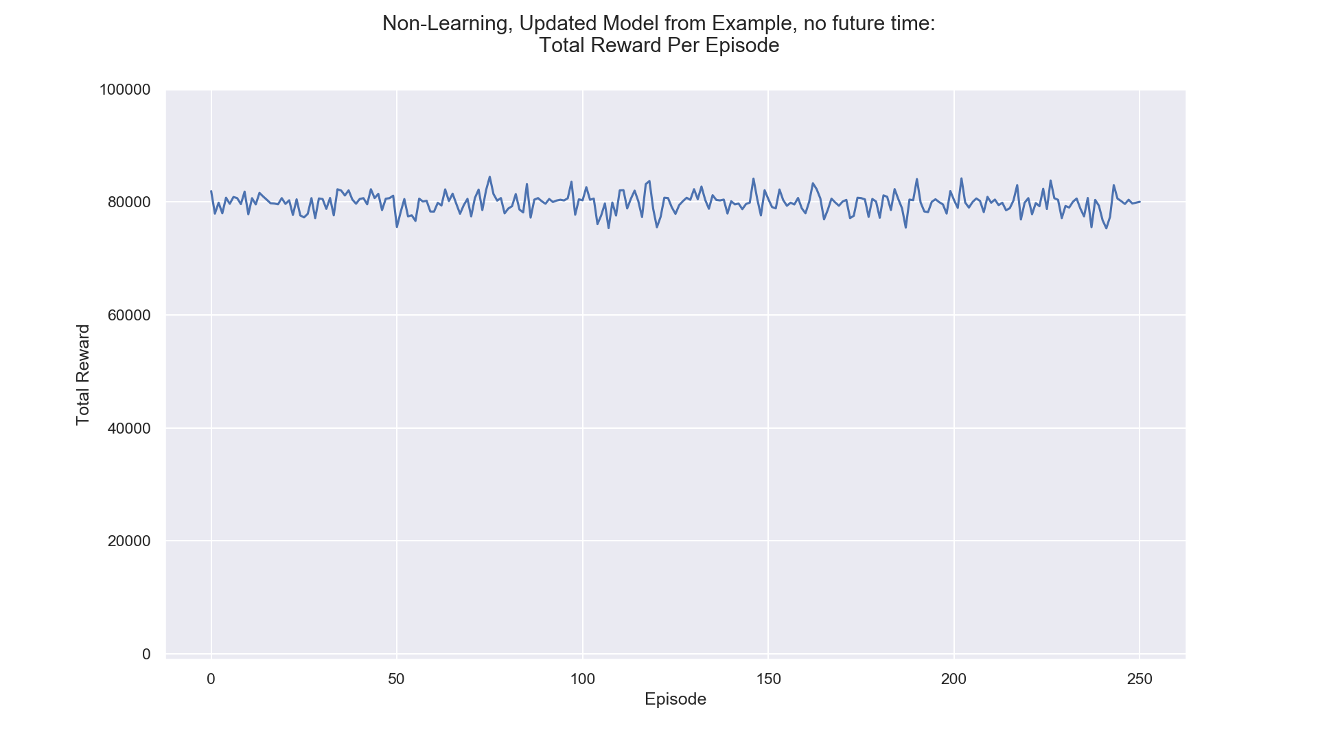
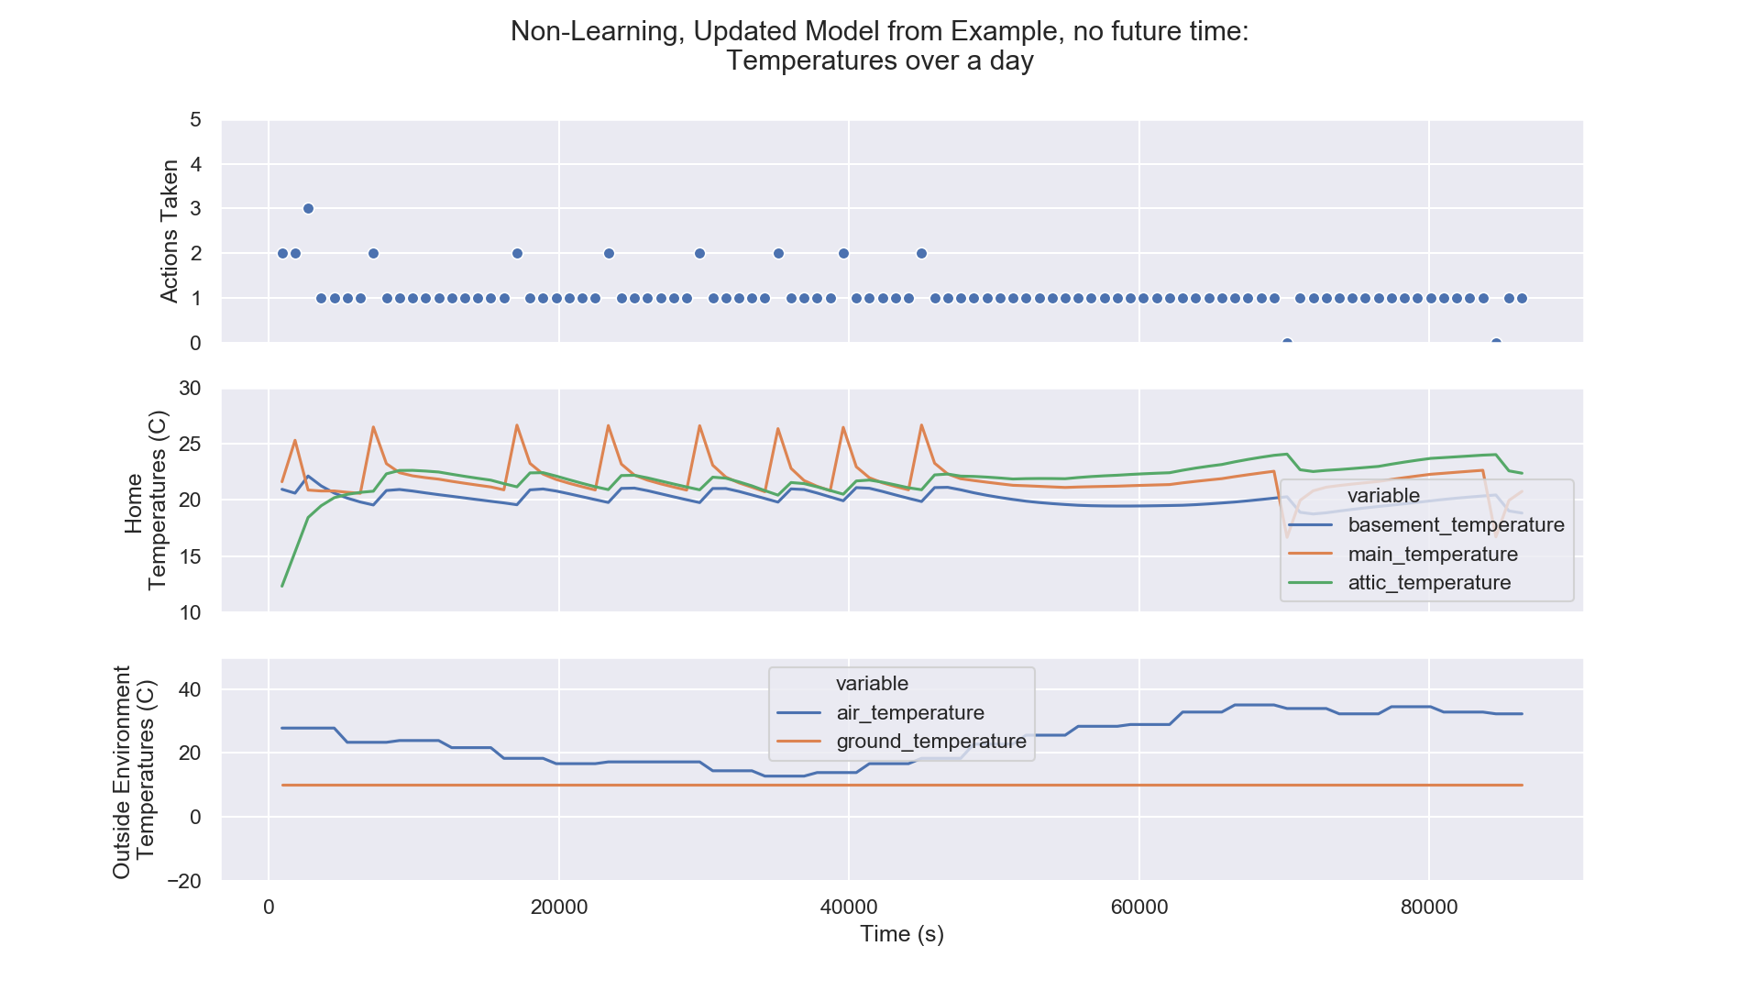
Results, Non-Learning New Model
This data is from a run using a prior learned model snapshot to maintain consistent results. This run also doesn’t perform any learning, it only uses the models built from previous learning runs.

Slide 11
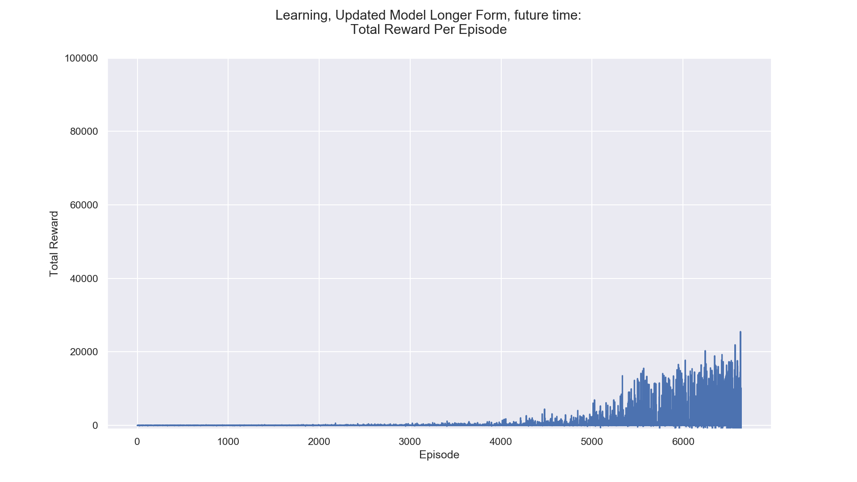
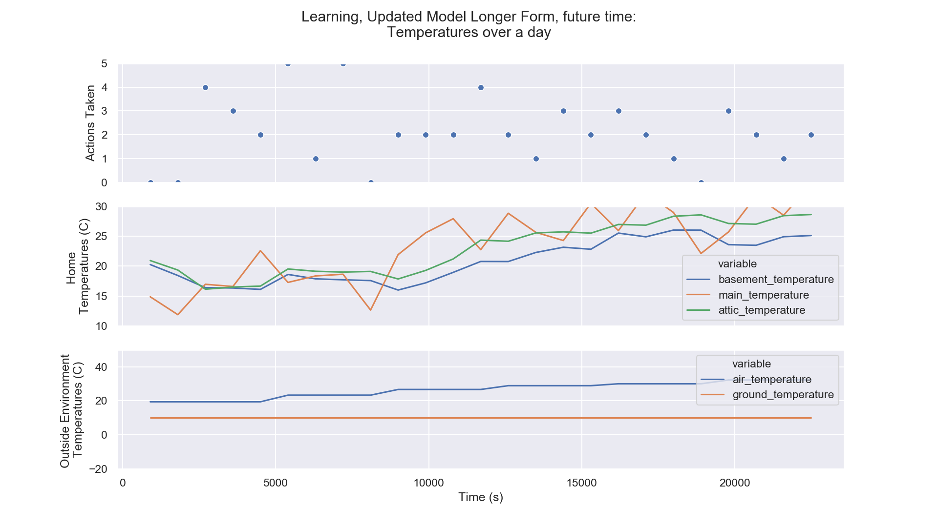
Results, New Model, with Future Temperature
This data is from the run of the custom model that also includes the future temperature in the observations. As you can see this model has a much different reward graph, taking much longer to start producing good results and improving upon those good results more slowly.

Slide 12
Summary, Future Work, and Conclusions
Summary:
Goal: A good model that minimizes energy cost and maximizes comfort.
Results: Successful and un-Successful tests of the simulator.
Future Work
Adding windows.
Add fans to outside world.
Adding individual room fans.
Work on improving and generating good models with current setup.
Hooking up to a physical system.
Conclusions:
A efficient optimized simulator is possible to build.
The current simulator can last indefinitely(the whole year) and do a good job.

Slide 13
References
https://climateaccountability.org/carbonmajors.html
https://www.ucsusa.org/resources/cooler-smarter-geek-out-data#.W-4zk-hKjD5

